Slide 1
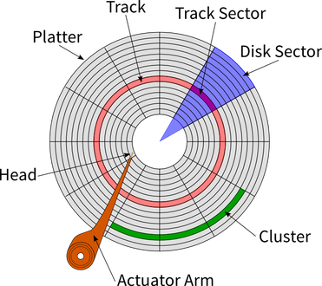
Priciple of Operation
Steps of LOOK algorithm works:
Initialisation : determine current position & direction moving of head.
Sorting Request Queue based on the information from Step 1.
Moves the head in the specified direction of travel.
Processing Requests one by one (including READ & WRITE data)
Change Direction When the head reaches the track closest to the request in the queue
200 tracks (contains 0~199)
Request Queue = {176, 79, 34, 60, 92, 11, 41, 114}
Current position of head = 50
Notes:
https://www.youtube.com/watch?v=Q2qcqX_hvR0 https://chat.openai.com/c/59feddb9-f395-4e64-b4bc-900f841e612a
https://blogs.umass.edu/Techbytes/2017/04/04/hard-drives-how-do-they-work/

Slide 2
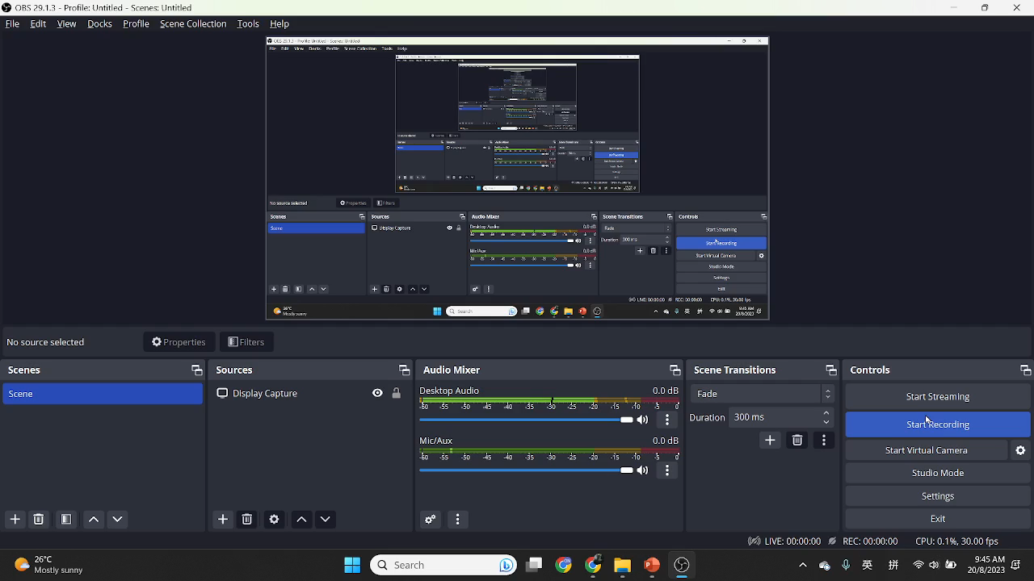
Notes:
https://www.youtube.com/watch?v=wtdnatmVdIg

